Slide 1

DIGITAL TWIN
PRESENTED BY:
NANDAN J S
1JS19CS096

Slide 2

AGENDA
INTRODUCTION
LITERATURE SURVEY
ARCHITECTURE / ALGORITHM
ADVANTAGES
APPLICATIONS
CONCLUSION AND FUTURE SCOPE
REFERENCES
2

Slide 3
INTRODUCTION
In recent years, Digital Twins (DT) have been implemented in different industrial sectors, in several applications areas such as design, production, manufacturing, and maintenance.
In particular, maintenance is one of the most researched applications, as the impact of the execution of maintenance task may have a great impact in the business of the companies.
Sensors and intelligent data acquisition are helping to improve the life cycle of any asset, starting from design, manufacturing, distribution, maintenance, until recycling.
These new technologies provide the necessary basis to enable the research on different areas such as fault prognostics and production efficiency among others.
3

Slide 4
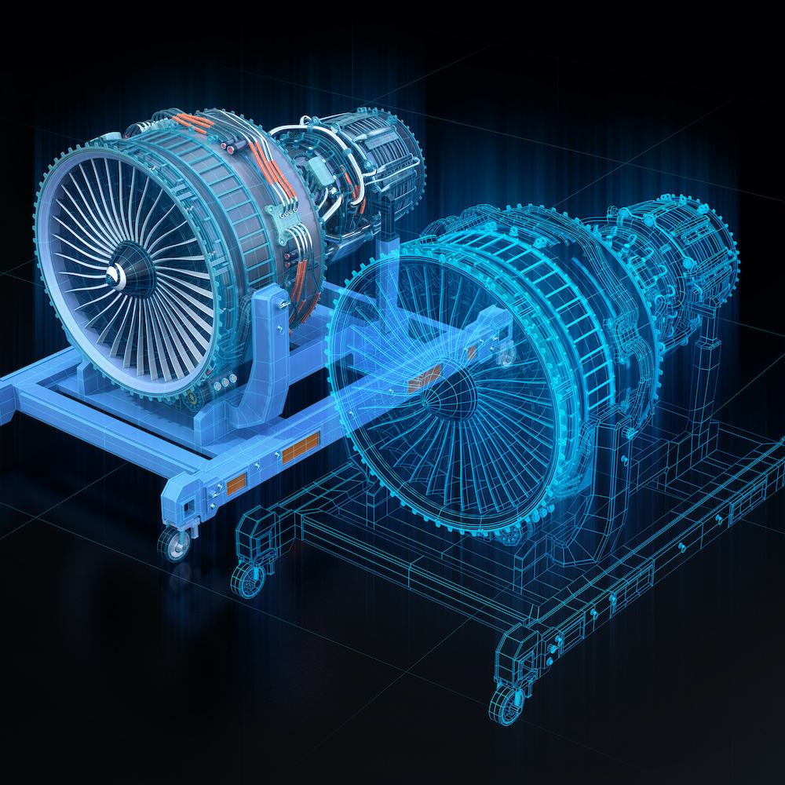
What is Digital twin?
A digital twin is a virtual model designed to accurately reflect a physical object.
It is a virtual copy of a real model to behave realistically.
The virtual model can be used to run simulations, study performance issues and generate possible improvements.
4

Slide 5
LITERATURE SURVEY
Nasa 2012 [5]
“A Digital Twin is an integrated multi physics, multi scale, probabilistic simulation of an
as built vehicle or system that uses the best available physical models, sensor updates, ﬂeet
history, etc., to mirror the life of its corresponding ﬂying twin.”
Chen 2017 [6]
“A digital twin is a computerized model of a physical device or system that represents all functional features and links with the working elements.”
Zheng et al. 2018 [8]
“A Digital Twin is a set of virtual information that fully describes a potential or actual physical production from the micro atomic level to the macro geometrical level.”
5

Slide 6
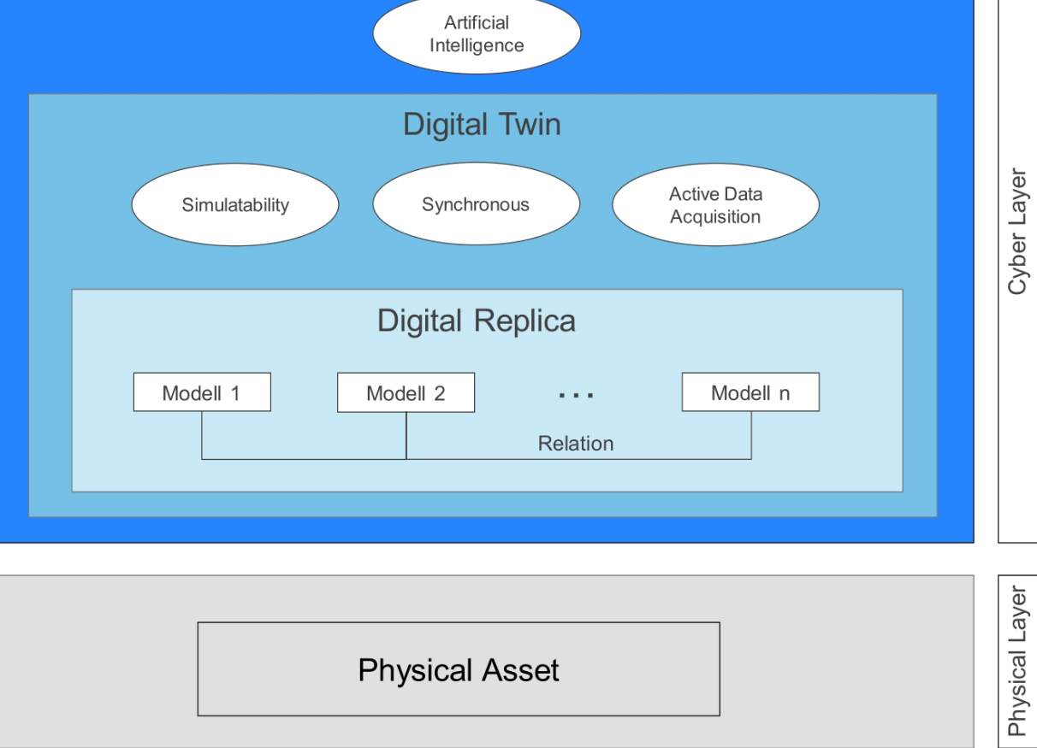
architecture
6

Slide 7
algorithm
Digital twin technology is the development of advanced ML algorithms deep neural network that can be readily used to update the model and make future predictions.
Derivative generalization method
Principal Component Analysis (PCA)
In the context of Machine Learning (ML), PCA is an unsupervised machine learning algorithm that is
used for dimensionality reduction.
7

Slide 8
Advantages
Accelerated risk assessment
Predictive maintenance
Real-time remote monitoring
Better decision-making
Reduction of maintenance costs
Improvement and optimization of production processes
8

Slide 9
Application
Manufacturing
Aerospace
Automotive
Self-driving car development
Healthcare
Improving personalized care
Construction
Energy
9

Slide 10
Conclusion
The growth in Digital Twin use has seen a shift in recent Years It would not be possible without the same growth in the AI, IoT and IIoT ﬁelds, which are becoming key enablers for Digital Twins
Digital twin technology combined with the latest machine learning and
artificial intelligence tools is helping companies across many industries reduce
operational costs, increase productivity, improve performance, and change the
way predictive maintenance is done. For product manufacturers.
Digital twin technology is helping us to achieving more efficient production lines and
faster time-to-market.
10

Slide 11
Future scope
This pairing of the virtual and physical worlds allows analysis of data and monitoring of systems to mitigate problems before they even occur, prevent downtime, develop new opportunities, and even plan by using simulations.
Sectors that benefit from digital twins include aerospace, defence, automotive, heavy machinery, consumer goods & electronics, power & energy etc
As per estimates, the market for digital twin is set to grow at a rate of more than 30% per year from 2020 till 2025 as an increase in demand for IoT and cloud-based platforms.
11

Slide 12
references
PAPERS
IFAC paper on “DIGITAL TWIN IN MANUFACTURING” BY *Werner Kritzinger &
*Matthias Karner
IEEE paper on “DIGITAL TWIN: ENABLING TECHNOLOGIES, CHALLENGES AND OPEN REASEARCH” by *Aidan Fuller.
IEEE paper on “DIGITAL TWIN POWERING THE ENTERPRISE METAVERSE” by
*Roberto Saracco.
WEBSITES
research.aimultiple.com/digital-twin-applications
globallogic.com/insights/blogs/if-you-build-products-you-should-be-using-digital-twins
researchgate.net/publication/_Digital_Twin_Architecture_and_Standards
12

